Slide 1
Multimedia Computing
By
Minhaz Uddin Ahmed, PhD
Department of Computer Engineering
Inha University in Tashkent.
Email: minhaz.ahmed@gmail.com

Slide 2
Content
Chapter - 9 (Gonzalez books)
Morphological operation
Dilation
Erosion
Opening
Closing

Slide 3
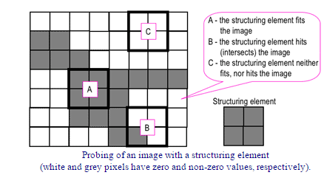
Basic concepts
Morphological image processing is a collection of non-linear operations related to the shape or morphology of features in an image.

Slide 4
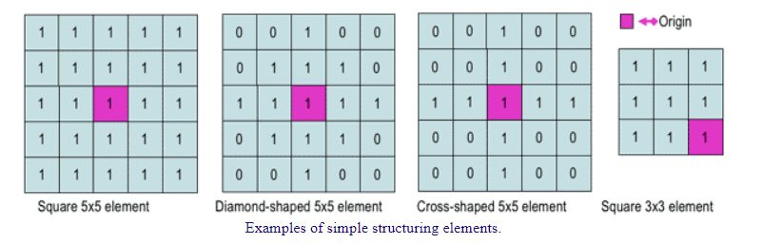
Structuring element
The structuring element is a small binary image, i.e. a small matrix of pixels, each with a value of zero or one:
The matrix dimensions specify the size of the structuring element.
The pattern of ones and zeros specifies the shape of the structuring element.
An origin of the structuring element is usually one of its pixels, although generally the origin can be outside the structuring element.

Slide 5
Morphological image processing
A common practice is to have odd dimensions of the structuring matrix and the origin defined as the centre of the matrix. Structuring elements play in morphological image processing the same role as convolution kernels in linear image filtering.

Slide 6
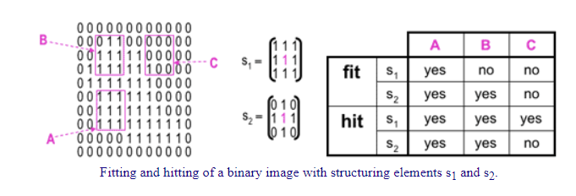
Morphological image processing
When a structuring element is placed in a binary image, each of its pixels is associated with the corresponding pixel of the neighborhood under the structuring element. The structuring element is said to fit the image if, for each of its pixels set to 1, the corresponding image pixel is also 1. Similarly, a structuring element is said to hit, or intersect, an image if, at least for one of its pixels set to 1 the corresponding image pixel is also 1.
Zero-valued pixels of the structuring element are ignored, i.e. indicate points where the corresponding image value is irrelevant.

Slide 7
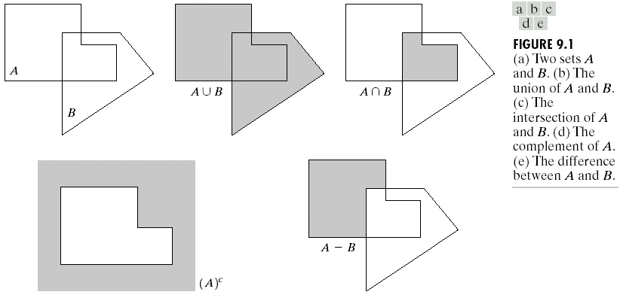
Some Basic Concepts from Set Theory

Slide 8
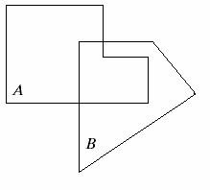
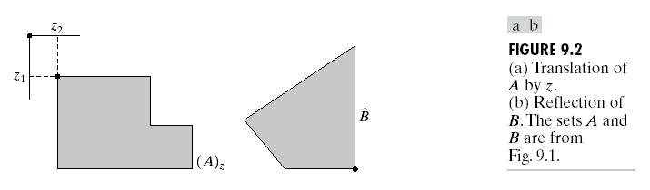
Some Basic Concepts from Set Theory
Translation
Reflection

Slide 9
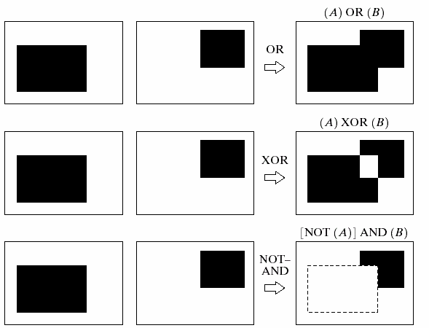
Logic Operations Involving Binary Images
A
B

Slide 10
Basic concept
Morphological operations rely only on the relative ordering of pixel values, not on their numerical values, and therefore are especially suited to the processing of binary images. Morphological operations can also be applied to grayscale images such that their light transfer functions are unknown and therefore their absolute pixel values are of no or minor interest.

Slide 11
Basic Morphological operation
A set of operations that process images based on shapes. Morphological operations apply a structuring element to an input image and generate an output image.
The most basic morphological operations are two: Erosion and Dilation. They have a wide array of uses, i.e. :
  Removing noise
  Isolation of individual elements and joining disparate elements in an image.
  Finding of intensity bumps or holes in an image

Slide 12
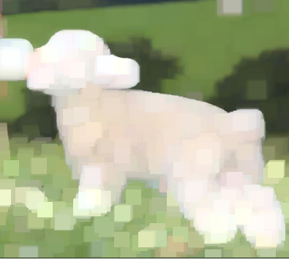
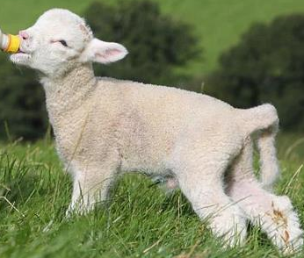
Dilation
This operations consists of convoluting an image A with some kernel (B),
which can have any shape or size, usually a square or circle.
The kernel B has a defined anchor point, usually being the center of the kernel.
As the kernel B is scanned over the image, we compute the maximal pixel value overlapped by and replace
the image pixel in the anchor point position with that maximal value. As you can deduce, this maximizing operation
causes bright regions within an image to “grow therefore name is dilation

Slide 13
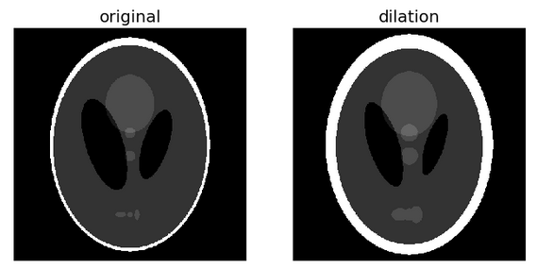
Dilation
Morphological dilation sets a pixel at (i, j) to the maximum over all pixels in the neighborhood centered at (i, j). Dilation enlarges bright regions and shrinks dark regions

Slide 14

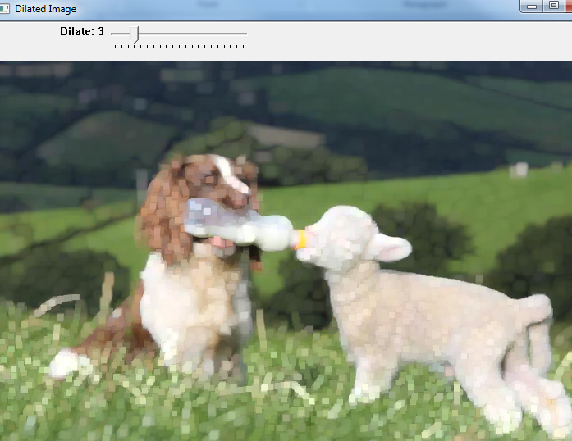
Dilation
Dilation

Slide 15
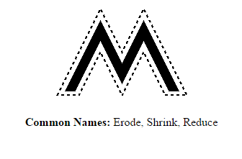
Erosion
The basic effect of the operator on a binary image is to erode away the boundaries of regions of foreground pixels (i.e. white pixels, typically). Thus areas of foreground pixels shrink in size, and holes within those areas become larger.

Slide 16
How it works
The erosion operator takes two pieces of data as inputs.
The second is a set of coordinate points known as a structuring element (also known as a kernel). It is this structuring element that determines the precise effect of the erosion on the input image.

Slide 17
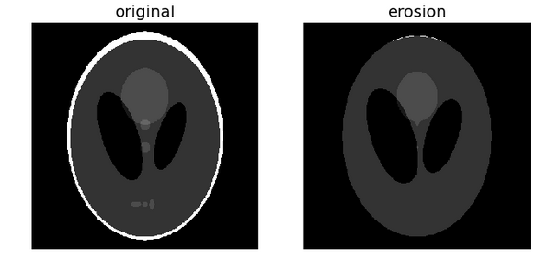
Erosion

Slide 18
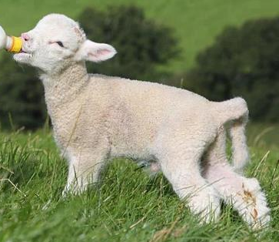
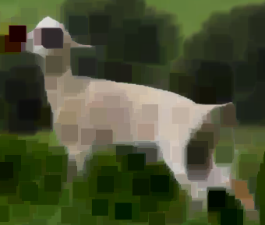
Erosion
This operation is the sister of dilation. What this does is to compute
a local minimum over the area of the kernel.
As the kernel B is scanned over the image, we compute the minimal pixel value overlapped by and replace the image pixel under the anchor point with that minimal value.
erosion operator to the original image (shown below). You can see in the result below that the bright areas of the image
(the background, apparently), get thinner, whereas the dark zones gets bigger.

Slide 19
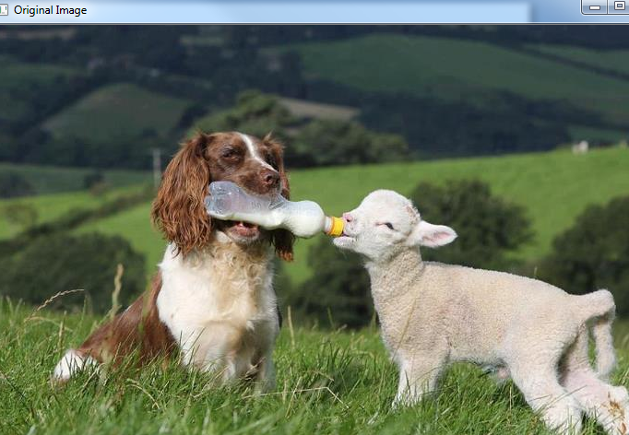
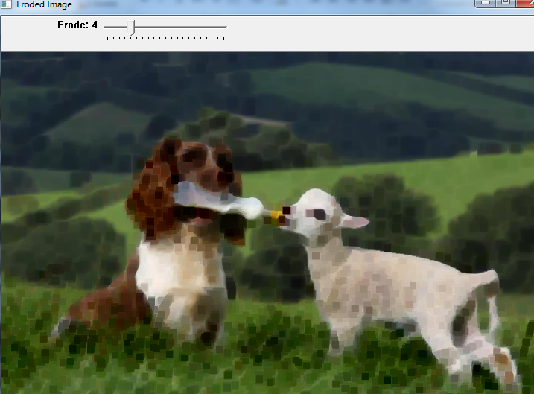
Erosion

Slide 20
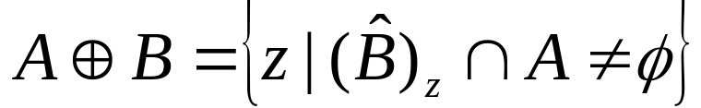


Dilation and Erosion Dilation
With A and B as sets in Z², the dilation of A by B is defined as
where : the reflection of B about its origin and shifting this reflection by z
The dilation of A by B is the set of all displacements, z, such that and A overlap by at least one element. Thus,
Set B is referred to as the structuring element in dilation.

Slide 21
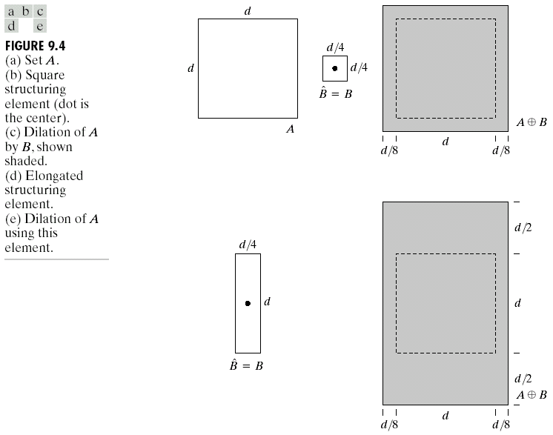
Dilation and Erosion Dilation

Slide 22
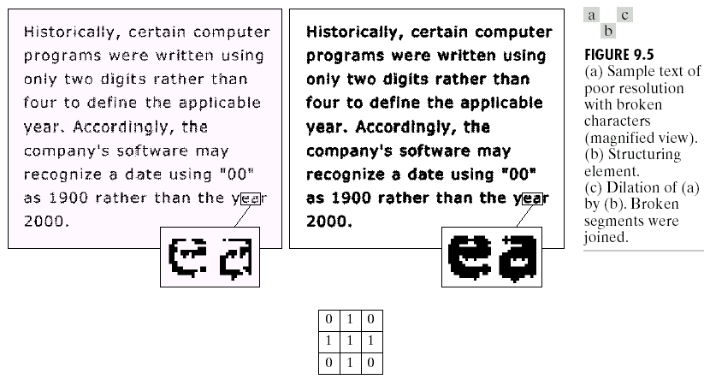
Dilation and Erosion Dilation Example
Structuring element

Slide 23

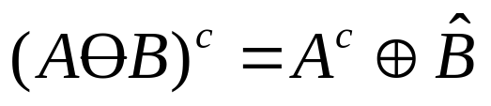
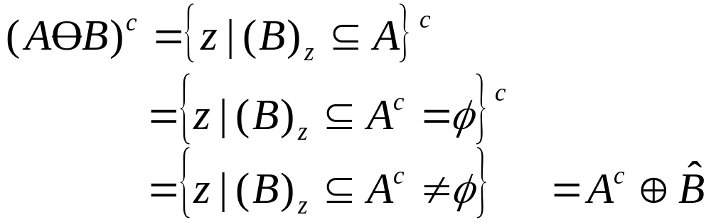
Dilation and Erosion
Erosion
For sets A and B in Z², the erosion of A by B is defined as
where : the reflection of B about its origin and shifting this reflection by z
The erosion of A by B is the set of all points z, such that B, translated by z is contained in A.

Slide 24
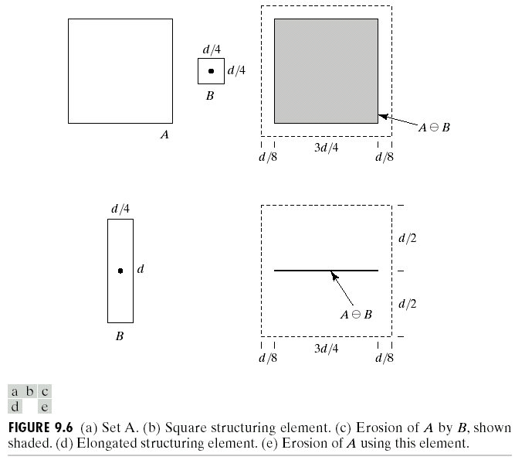
Dilation and Erosion
Erosion

Slide 25
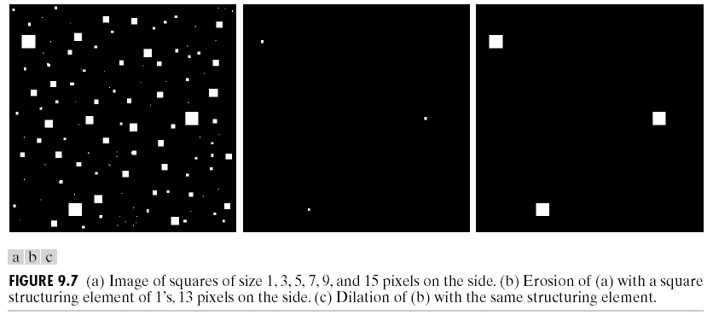
Dilation and Erosion
Erosion Example

Slide 26
Opening
It is obtained by the erosion of an image followed by a dilation.
The basic effect of an opening is somewhat like erosion in that it tends to remove some of the foreground (bright) pixels from the edges of regions of foreground pixels.
Opening can remove small bright spots and connect small dark cracks.

Slide 27
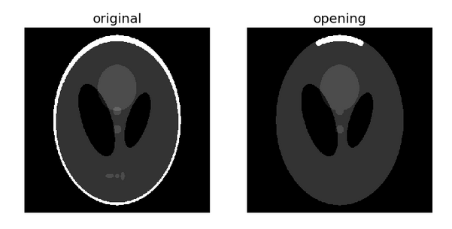
Opening

Slide 28
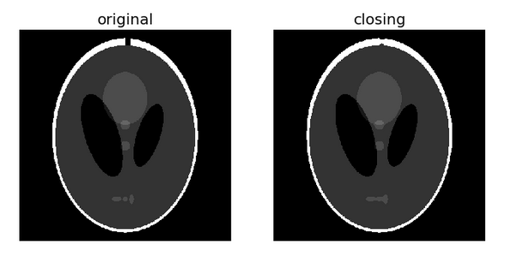
Closing
Morphological closing on an image is defined as a dilation followed by an erosion. Closing can remove small dark spots and connect small bright cracks.

Slide 29
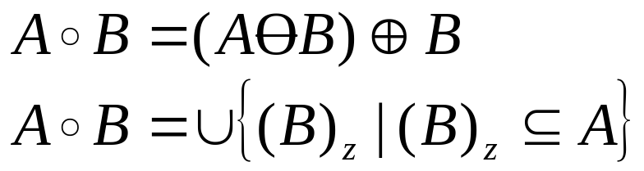
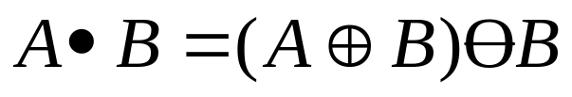
Opening and Closing
Opening:
  smooth the contour of an object, break narrow isthmuses, and eliminate thin protrusions.
  The opening A by B is the erosion of A by B, followed by a dilation of the result by B
Closing:
  smooth sections of contours but it generally fuses narrow breaks and long thing gulfs, eliminates small holes, and fills gaps in the contour.

Slide 30
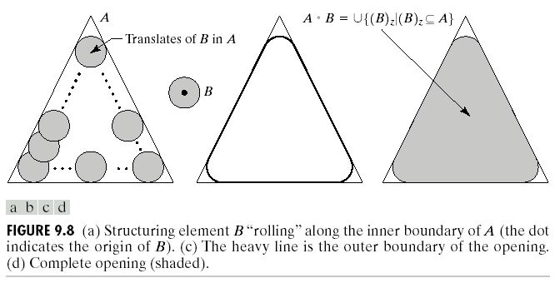
Opening and Closing
Opening

Slide 31
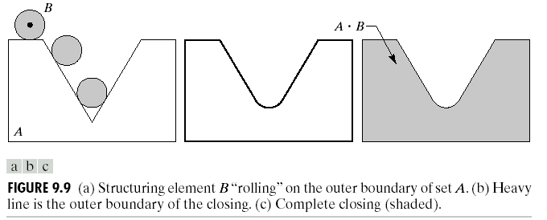
Opening and Closing
Closing

Slide 32
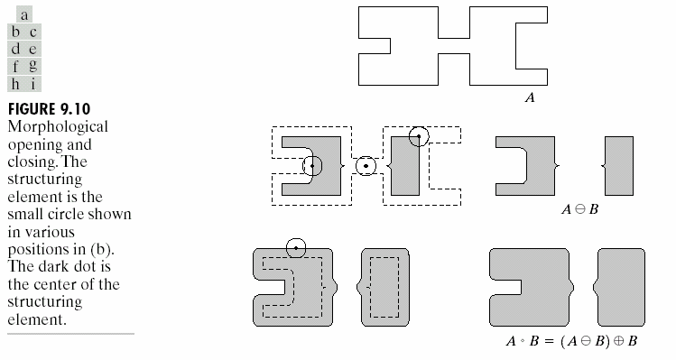
Opening and Closing
Opening Example

Slide 33
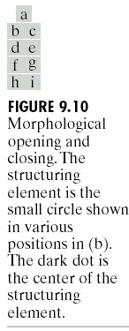
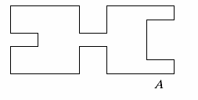
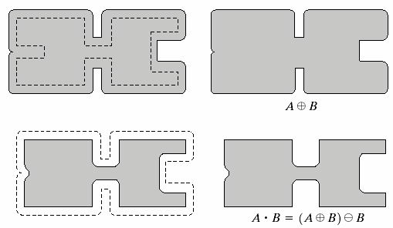
Opening and Closing
Closing Example

Slide 34








Opening and Closing
The opening operation satisfies the following properties:
  is a subset (subimage) of A.
  If C is a subset of D, then is a subset of .
The closing operation satisfies the following properties:
  A is a subset (subimage) of .
  If C is a subset of D, then is a subset of .

Slide 35
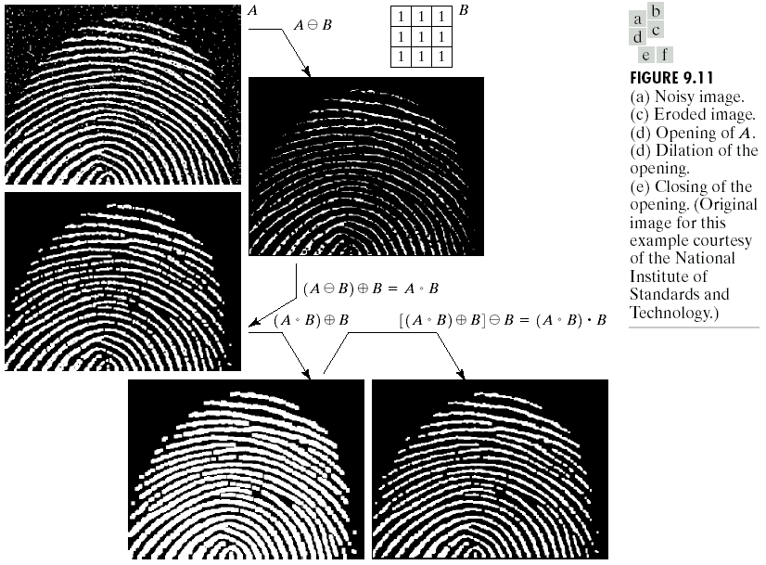
Opening and Closing

Slide 36
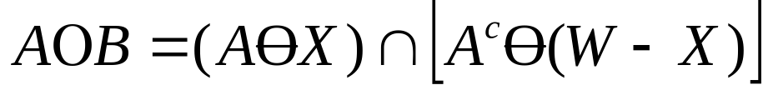

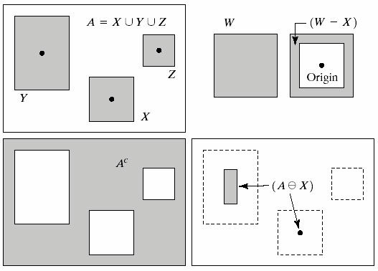
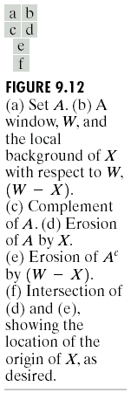
The Hit-or-Miss Transformation
＊

Slide 37
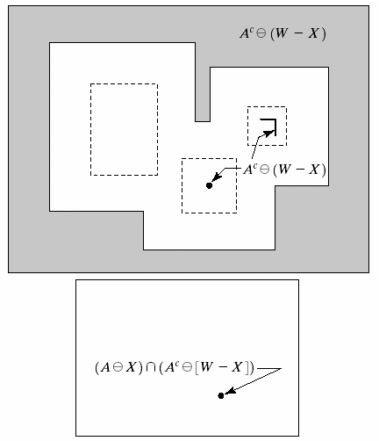
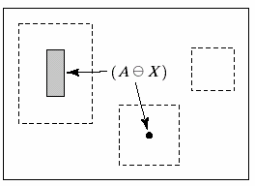
The Hit-or-Miss Transformation
＊

Slide 38

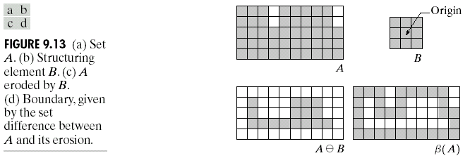
Some Basic Morphological Algorithms
Boundary Extraction
The boundary of a set A,
where B is a suitable structuring element.

Slide 39
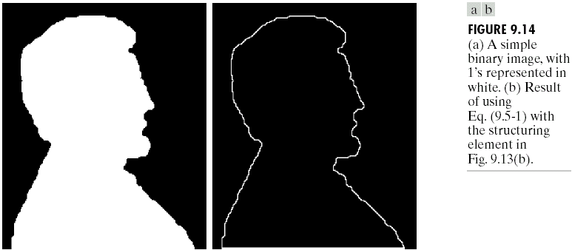
Some Basic Morphological Algorithms
Boundary Extraction Example

Slide 40
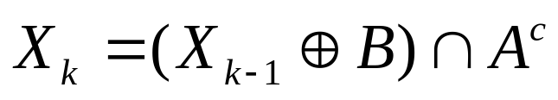
Some Basic Morphological Algorithms
Region Filling
The following procedure can fill the region:
where X₀ = p, and B is the symmetric structuring element shown in Fig. 9.15.
Note that p is the initial point we should assign.

Slide 41
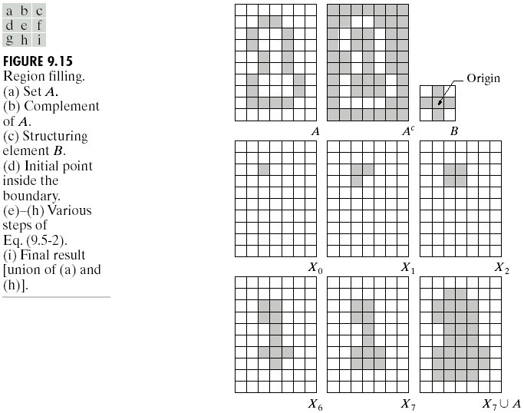
Some Basic Morphological Algorithms
Region Filling
0
1
X₀=p

Slide 42
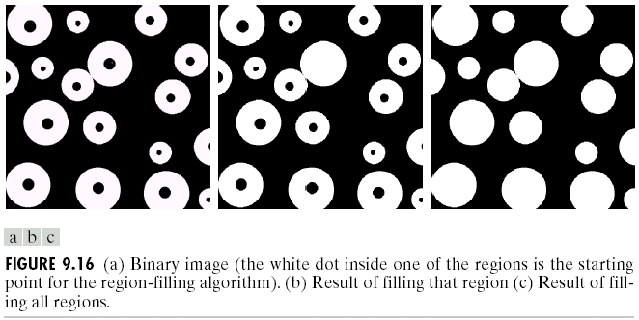
Some Basic Morphological Algorithms
Region Filling

Slide 43
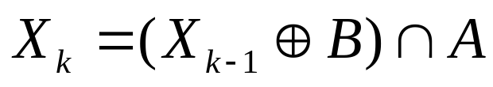
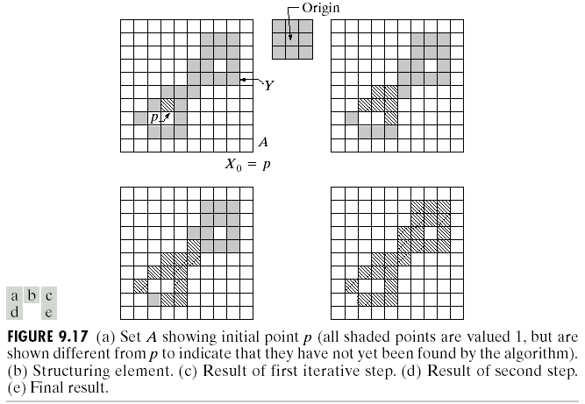
Some Basic Morphological Algorithms
Extraction of Connected Components

Slide 44
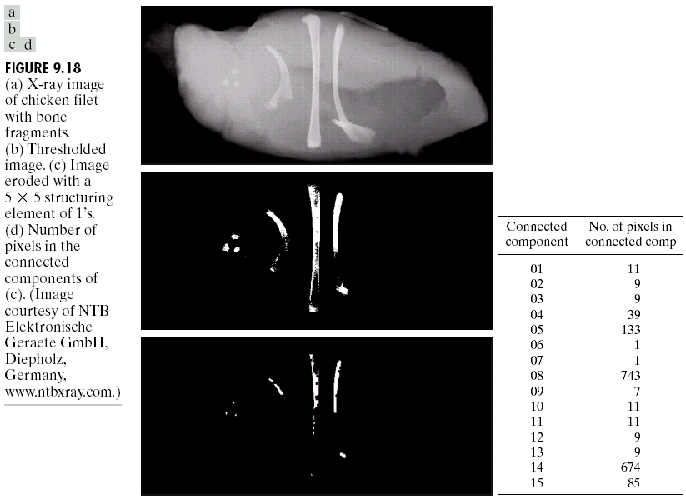
Some Basic Morphological Algorithms
Extraction of Connected Components

Slide 45
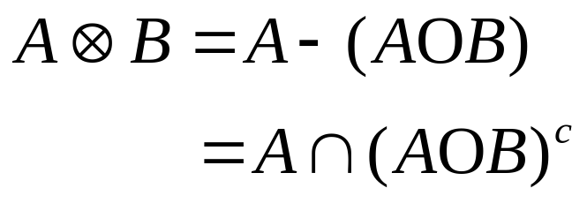
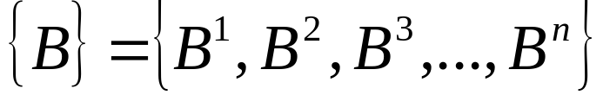
Some Basic Morphological Algorithms
Thinning
The thinning of a set A by a structuring element B can be defined in terms of the hit-or-miss transform:
A more useful expression for thinning A symmetrically is based on a sequence of structuring elements:
＊
＊

Slide 46

Some Basic Morphological Algorithms
Thinning

Slide 47

Some Basic Morphological Algorithms
Skeletons

Slide 48

Summary of Morphological Operations
and Their Properties

Slide 49

Summary of Morphological Operations
and Their Properties

Slide 50

Summary of Morphological Operations
and Their Properties

Slide 51

Summary of Morphological Operations
and Their Properties

Slide 52

Extensions to Gray-Scale Images

Slide 53

Extensions to Gray-Scale Images

Slide 54


Extensions to Gray-Scale Images

Slide 55
Morphological Gradient
The morphological gradient is the difference between the dilation and erosion of an image.
To highlight the boundaries or edges of objects in the image.
By subtracting the eroded image from the dilated image, the boundaries of the objects are emphasized.

Slide 56
Top-Hat Transform
The top-hat transform is used to extract small elements and details from an image.
To enhance bright objects on a dark background or vice versa.
There are two types: white top-hat (original image minus the result of opening) and black top-hat (result of closing minus the original image)

Slide 57
Skeletonization
Skeletonization reduces objects in a binary image to their skeletal form.
To simplify objects to their essential structure while preserving their connectivity.
It iteratively erodes the image until the objects are reduced to a minimal, skeletal form.

Slide 58
Pruning
Pruning removes small spurs or extraneous branches from the skeleton of an image.
To clean up the skeleton by removing unwanted artifacts.
It identifies and removes small, irrelevant branches from the skeletonized image.

Slide 59

Reference

Slide 60

Question

Slide 61

Thank you

